Slide 1
RUNTIME VERIFICATION FOR SPATIO-TEMPORAL PROPERTIES OVER IOT NETWORKS
Second partial release of the project
DEGREE IN COMPUTER ENGINEERING
Oihana Garcia Anakabe
2021/2022

Slide 2
Index
Introduction
Development
Problems and solutions
Work done until now
Conclusion

Slide 3
Introduction
Description
Objectives
Product requirements

Slide 4
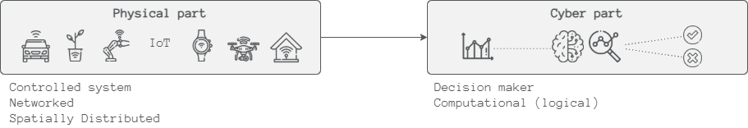
Description
CPS (Cyber Physical Systems) is one of the systems that can exploit an IoT infrastructure
IoT is a field that is growing fast (2030 → 25,44 billion worldwide connected devices)
In CPS physical systems are monitored and/or controlled by a computational core
Monitoring is an activity related to the wider category of Runtime Verification (RV)
The increasing numbers of IoT devices and intelligent systems made CPS influence society
Notes:
Monitoring is an activity related to the wider category of Runtime Verification (RV), which purpose is to observe information from a system while it is operating and analyse the behaviour to detect if it satisfies or violates certain properties.
Monitoring the status of a CPS at runtime can give precise information to ensure reliability, safety, robustness and security
The increasing numbers of IoT devices and intelligent systems made CPS influence society:
Self-driving cars
Home equipment
Medical devices

Slide 5
Objectives
This project focuses precisely on the challenges when doing monitoring on CPS over IoT.
Feed MoonLight monitor with live data
Implement a middleware that offers different services
Establish the communication between the sensors and the monitor
Adapt the received data to the monitor
Show the results to the user
Notes:
The objective of this project is to feed MoonLight (the provided monitor) with live data. Moonlight previously has been tested with a Matlab interface since this tool has several CPS models and analysis tools available [7]. With that being said, this is the first time for the monitor to receive real data, so the purpose of this project is to help MoonLight be able to monitor different use cases and see how it works with actual real time data.

Slide 6
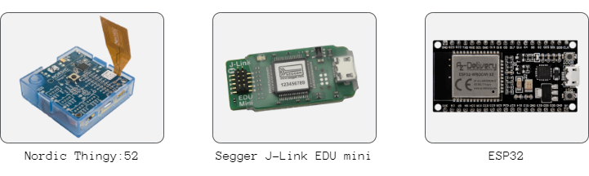
Product requirements
Software
Hardware
Moonlight
Zephyr and Arduino
Thingsboard

Slide 7
Development
Moonlight online monitor
Moonlight features
Middleware
SOA
Physical system

Slide 8
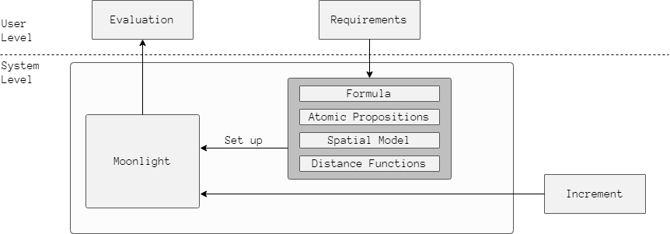
Moonlight online monitor
Online monitor

Slide 9
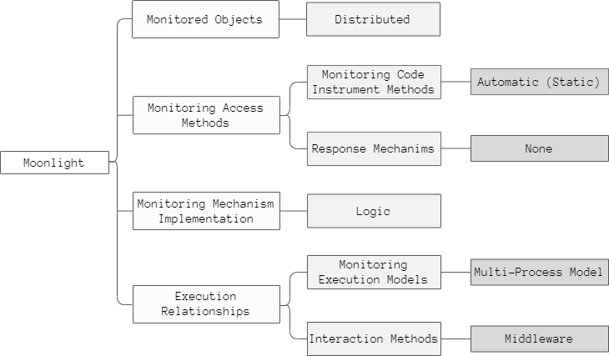
Moonlight features

Slide 10
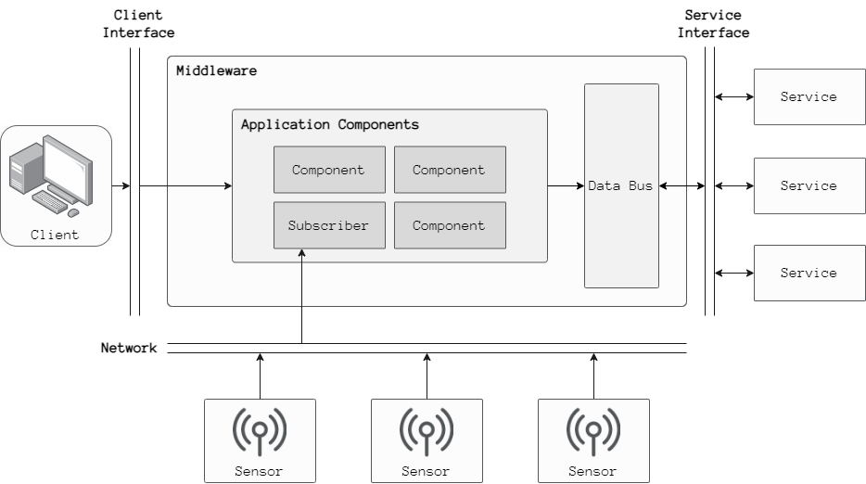
Middleware

Slide 11
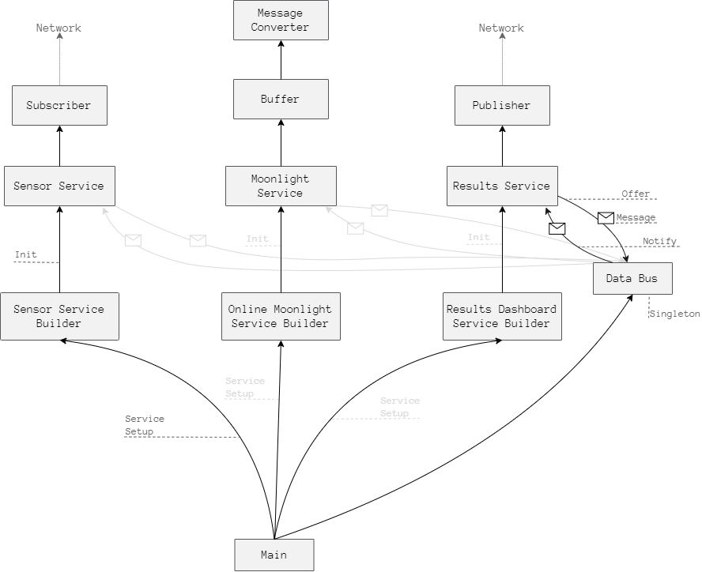
SOA

Slide 12
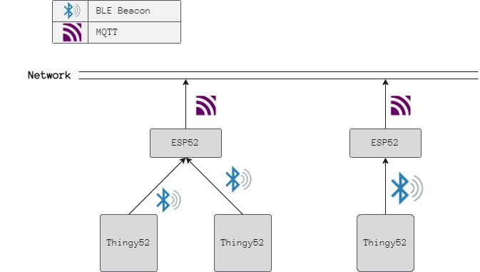
Physical system

Slide 13
Problems and solutions
Sensors time synchronization
Missing values and imprecise signals
Other problems

Slide 14
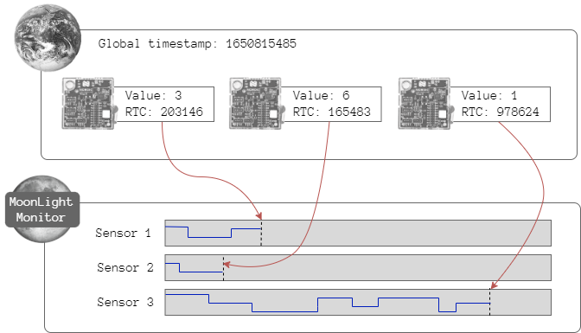
Sensors time synchronization
Problem
Solution
Time List
203146
165483
97624

Slide 15
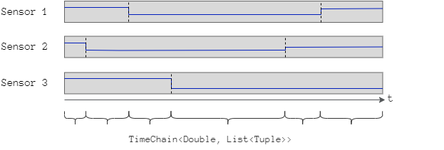
Missing values and imprecise signals
Problem
Solution
Not all the sensors send the data at the same time
There are gaps between each sensor’s messages
The time interval between messages can change

Slide 16
Other problems
MoonlightRecord (a Moonlight java class) had some problems:
Escape formula + online monitor + MoonlightRecord = infinite loop
MoonlightRecord null values didn’t throw errors, wrong error handling
Solution: Notify this error to Ennio → He created Tuple a class that works in the same way but without problems
I was having problems with Windows + Zephyr project
Solution: Use ubuntu

Slide 17
Work done until now
Results until now
Work in process
Future work

Slide 18
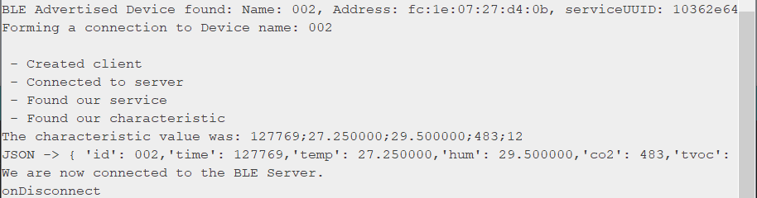
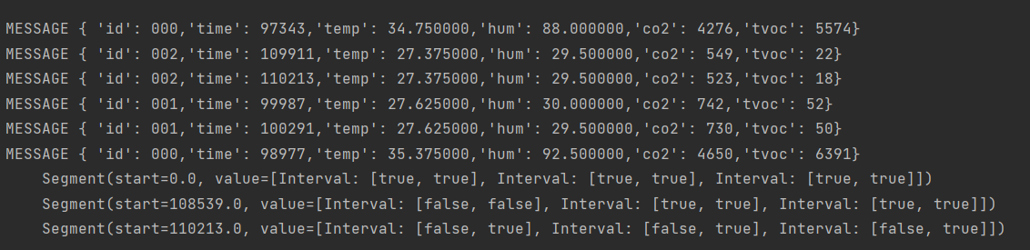
Results

Slide 19
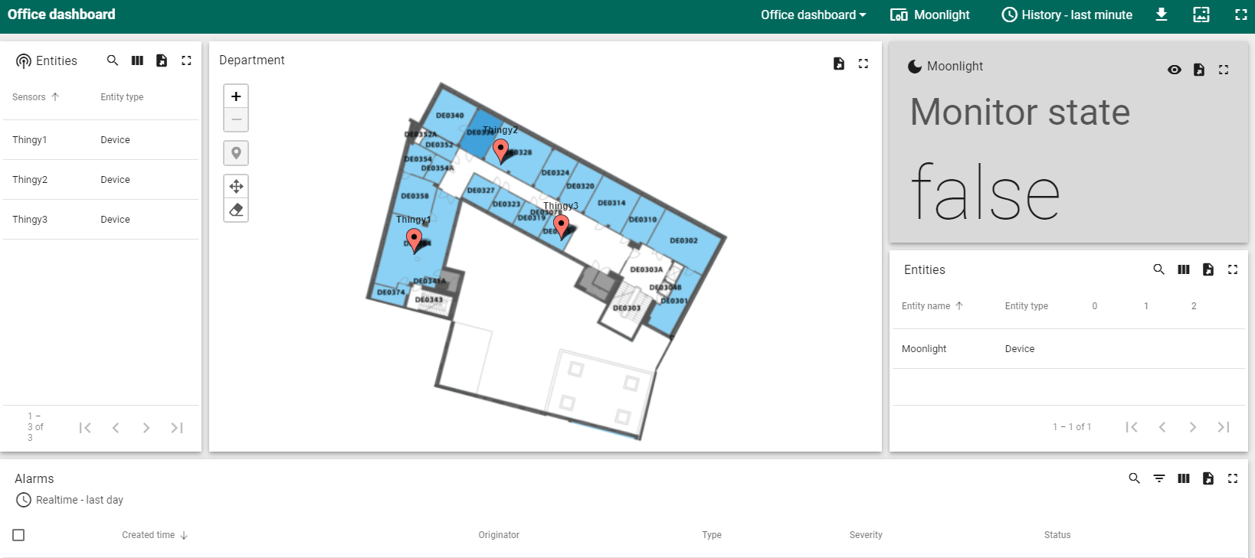
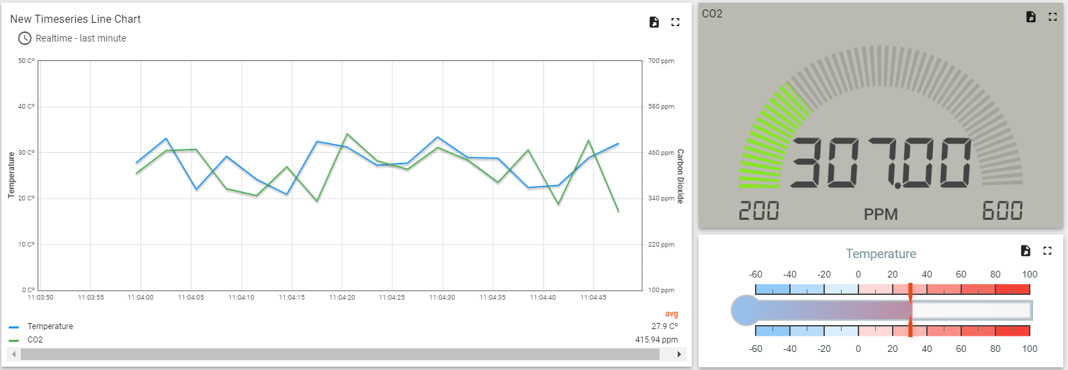
Work in process

Slide 20
Future work

Slide 21
Conclusions
Technical conclusions
Future lines

Slide 22
Technical conclusions

Slide 23
Future lines

Slide 24
Thank you
Eskerrik asko

